Slide 1
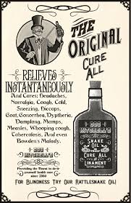
A Turn of a Phrase into Fields or The Magic Behind Clinical Natural Language Processing for Epidemiological Studies, Surveillance, and Quality Metrics
Guy Divita
University of Utah School of Medicine
VA HS R&D Salt Lake
April 21, 2017

Slide 2
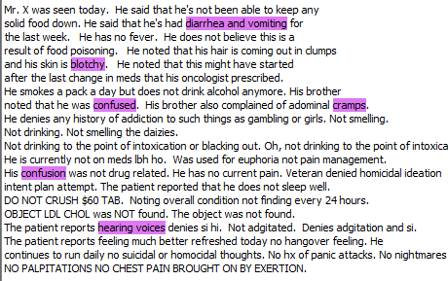
Symptoms

Slide 3
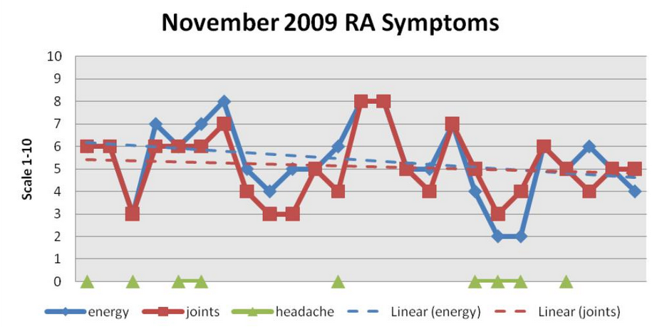
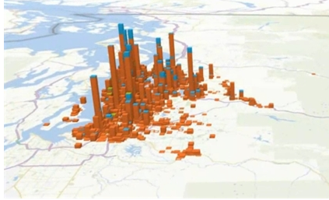
Introduction
Substantial amounts of Clinically significant information ONLY contained in the unstructured medical notes or under reported
Goal: Transform relevant instances found in notes into discrete data

Slide 4
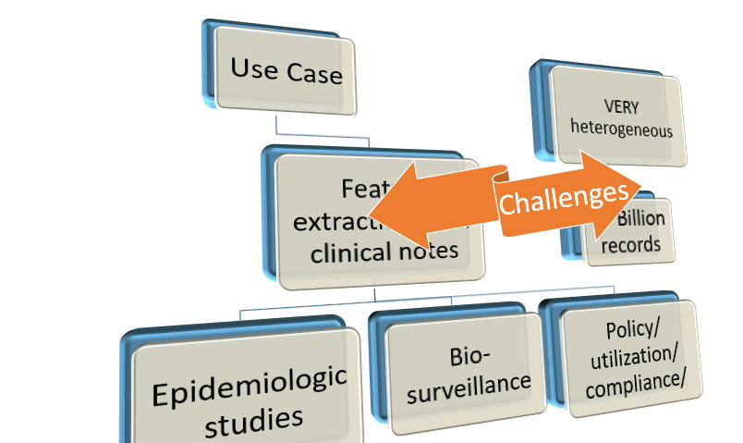
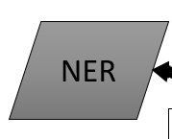
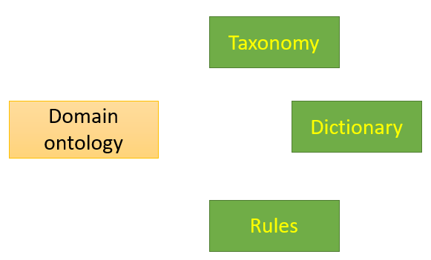
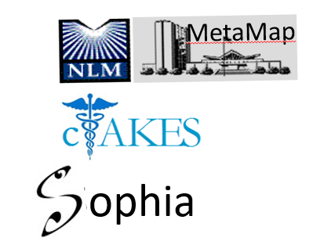
Road Map
High Profile Projects using NLP
Named Entity Recognition
Use Case
Favorite NLP Recipe
domain ontology

Slide 5
Use Case
Challenges
Use Case
Feature extraction from clinical notes
Epidemiologic studies
Bio-surveillance
VERY heterogeneous
Policy/ utilization/ compliance/
2+ Billion records
Notes:
Here is the use case – we are tasked with doing feature extraction from VA clinical notes for
the purposes of
epidemiological studies
bio-surveillance
Policy
utilization
compliance
quality assertion
(click)
Within an environment that is Very heterogeneous
with billions of records

Slide 6
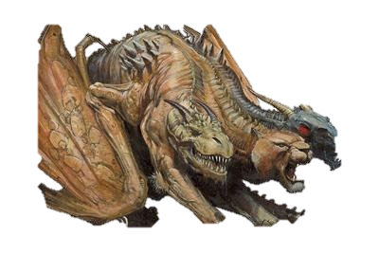
Concept Extraction Challenges
Semi structured text
Slot: Value pain scale: 7
Contextual statements
About the patient brother had mi
History of h/o sob
Questions Have you had …
Fill in the blank Days sick ___
Hypothetical May experience
Conditional p.r.n. pain
Negation denies alcohol
Check boxes [ ] yes [ x ] no
5000 Types of records
Nursing Notes
Surveys
Group Discussions
Notes:
Heterogeneous in the sense that these records are replete with semi-structured components including
slot: value structures – for example pain scale: 7
check boxes
questions and their answers
fill in the blank kinds of boiler plate
Where we have to worry about contextual environment including
whether the statement is about the patient or not,
whether the statement is about something in the past
whether the statement is conditional, for instance, take this for pain
and of course
negation
Where many studies include two or three document types like discharge summaries, and history and physicals,
the 2 billion plus records in this corpus have 2700 types of records including surveys, group discussions along the expected kinds of records
click
These are the demons that we deal with

Slide 7
Theme
Call on NLP when your eureka feature is not in structured data
Call on NLP when your eureka feature is under-reported in structured data

Slide 8
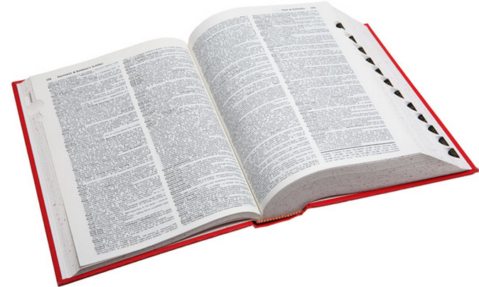
Background: Natural Language Processing Techniques
UMLS Mapping Tools:
UMLS
MetaMap
id: C0018681
Concept: headache
Semantic Type: Sign or Symptom
Synonyms: head-ache
ha
h/a
Sophia
Patient presents with headache and general fatigue.

Slide 9
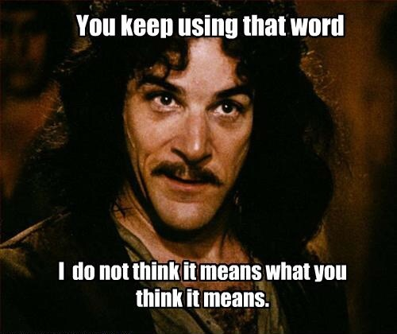
A Place for Everything: Domain ontology
Domain ontologies used to hold the ‘guts’ of NLP
Domain ontology:
A container for knowledge Acquisition
Taxonomy
Domain ontology
Dictionary
Rules

Slide 10
A Place for Everything: Domain ontology
Taxonomy: a set of categories joined by is-a relationships
Taxonomy
Category
Problem
Abnormal Behavior
Sign or Symptom
Pain
Clinical Text
Domain Ontology
Pain

Slide 11
A Place for Everything: Domain Ontology
Dictionary has entries.
Each Entry has a category from the taxonomy
A “lookup” index is made out of each variant of each entry
Spelling Variants
Definition
Inflections
Variants
Entry
Synonyms
Category
Dictionary
Acronyms
Domain Ontology

Slide 12
What’s in Your Dictionary?
Entry categories
Map to asserted mentions in text
Multi-word entries (reduce ambiguity)
Negative evidence categories
Patient presented with head-ache and stomachache.
Patient reports chest pain and SOB
Patient’s output from urinal was 20ml
Dictionary

Slide 13
A Place for Everything: Domain ontology: Rules
Rules include regular expressions
Each regular expression has a category
Rules that involve an anchor, evidence and constraints
Anchor Category
Evidence Category
Rule
Rules
Category
Pre |Post | Terminal
Rules
Pattern
Regular Expressions
Domain Ontology
Category

Slide 14
A Place for Everything: Domain ontology: Rules
Example
Temp: 101.2 f
Temperature
See Slide:
Clinical Text
Temp: 101.2 f
[Temp:]* (\d[2]|\d[3]) (\.\\d[1])[1][degrees]*[f|c]*
Regular Expression
Temperature

Slide 15
A Place for Everything: Domain ontology: NER
Named Entity Recognizer (NER)
Dictionary Lookup
Lexical Lookup
Taxonomy
NER
Dictionary
Part-of
Part-of
Rules

Slide 16
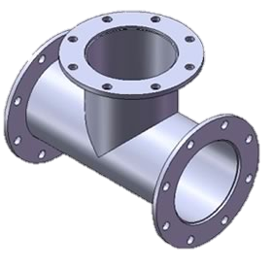
NER Mechanics
Annotator + Annotator = Pipeline
Dictionary Lookup
Medical Text
conTEXT
Potential Symptom
Modifiers
Activities
Anatomical Parts
POS
Term
Question Identification
Sentence
Slot: Value
Check Box
Line
Tokenizer
Sectionizer
Final Symptom

Slide 17
Scaled-up Pipelines (multi-threading/multi-process)
Pipeline + Pipeline = Phat Pipeline
Medical Text
Separate Threads for Replicated Pipelines
One Java Process

Slide 18
When Dictionary Lookup Just Isn’t Good Enough
See your Computer Scientist if you experience
Too many false positives
Your precision is low
Your recall is ok or high
Ask your Computer Scientist if Machine Learning is right for you
Can use your NER to find features
You have a Gold Standard to learn from
Can use a learned model to filter out #)*$@ mentions
(un-mentionables)

Slide 19
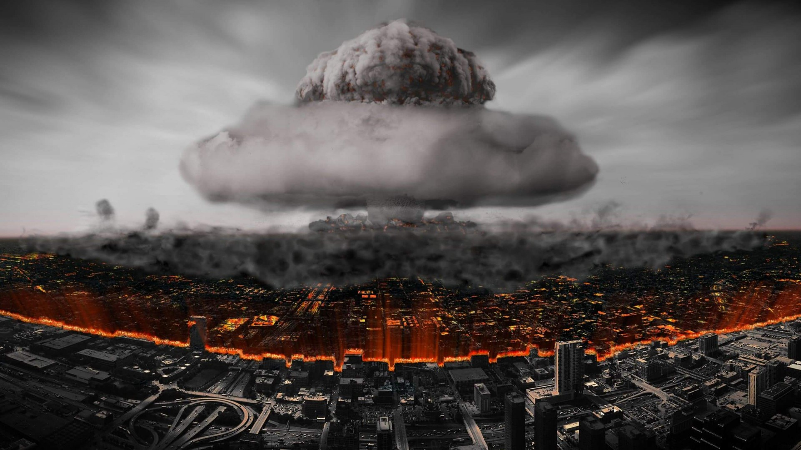
High Profile Projects
Predicting homelessness - under reported
General symptom extraction - under reported
Military Sexual Trauma (MST) - under reported
CAUTI - Not in structured text
Colonoscopy Quality QUERI - Not in structured text

Slide 20
Using Psychosocial Risk factor Mentions in Clinical Notes to Predict Homelessness
Why
High priority within the VA
Risk factors underreported and not well documented in EMR
Work Done
Dictionary Based Extraction
Based on field experts + literature search + UMLS Terminology
Published Efficacy tested PPV: .8 from a 350K stratified sample across document types where the homelessness status was known
10.5 Million document cohort processed for
Machine Learning model combined with structured data

Slide 21
Homelessness (3)

Slide 22
Identifying General Symptoms within Clinical Notes using NLP
Why
Symptom identification is known to be underreported in EMR
Motivated by Medically Unexplained Syndrome task to identify clusters of common symptoms in OEF/OIF Veterans

Slide 23
Identifying General Symptoms within Clinical Notes using NLP (2)
Background
Symptom Terminology overlaps with a continuum of ambiguous terms including findings, diagnosis, diseases and syndromes.
Terminology not consistently classified in medical vocabularies (i.e. UMLS)
Pain not classified as symptom
Abnormal behavior not classified as symptom
Prior work using cTAKES + UMLS Symptom category reported to be f = .4
Needed something more specific than i2/b2 problems

Slide 24
Identifying General Symptoms within Clinical Notes using NLP (3)
Work Done
Lexicon of 92,000 symptoms derived from UMLS using novel technique
Symptoms classified by organ system via ICD-9 CM symptom tree + pain + …
Dictionary Lookup + Rules + Machine Learning using 62 features
Optimal Machine Learning algorithm derived from automated exhaustive permutations of weka algorithms and parameters
Published efficacy benchmarked at F = .80, Recall =.74 Precision = .80
Symptoms Extracted from a 1 million record cohort of OEF/OIF patients
Example Rules:
Normal behavior + abnormal modifier = symptom : trouble walking
Anatomical location + action = symptom : stabbing in leg
Other Symptom triggers : feels, like, as if

Slide 25
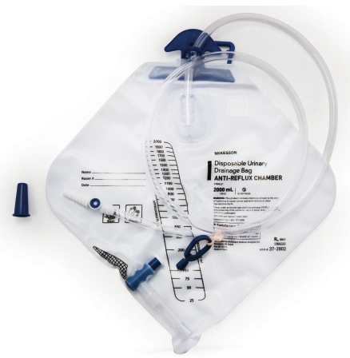
Identifying Patients with Catheter-Associated Urinary Tract Infections (CAUTI) using Clinical Notes
Why
VA hospitals want to reduce CAUTI rates
Can’t identify patients with urinary catheters from db
Urinary catheter mentions primarily in nurses notes
Work Done
Dictionary Lookup Extraction to identify patients with urinary catheters
Lexicon from prior art, vocabulary discovery around seed terminology usage in corpus
Published efficacy benchmarked: 98% PPV, 72% Recall
Machine learning model being developed with database fields on positively identified patients to detect infections and causes
Lessons Learned
Pertinent Negatives, negative evidence important

Slide 26
Identifying Patients Who Experienced Sexual Trauma From Clinical Texts
Why
Military Sexual Trauma identified as a priority in the Blueprint for Excellence
Under-reported in database but providers record patient experiences
Able to classify by childhood, adult, military
Preliminary Work
Dictionary based extraction
Initial terminology from experts in the field and prior art
Vocabulary discovery around seed terminology usage in large corpus
Templates identified and filtered out

Slide 27
Identifying Patients Who Experienced Sexual Trauma From Clinical Texts (2)
Efficacy:
Cohort: 10,000 Female, 10,000 Male patients chosen at random from OEF/OIF cohort who first received care at VA between 2010-2014.
1609 Patients (8.0%) included w/ MST Flag
362K clinical notes
Extracted, hand reviewed and classified 7,384 sexual trauma mentions
Identifying Sexual Trauma | PPV
Patients | .71
Mentions | .90

Slide 28
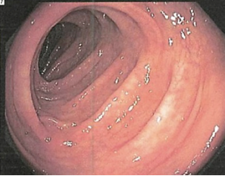
Colonoscopy Quality: Identifying Bowel Prep Quality from Clinical Texts
Why
VA provider adenoma discovery rates to be benchmarked
Bowel Prep quality is needed variable
Only contained in notes
Preliminary Work
Collaboration with other development groups
Dictionary + rule extraction tool created
1000 document hand annotated for training purposes
480 documents hand annotated for testing
Efficacy tested f=.82 (training f=.90)

Slide 29
Conclusions
Call upon NLP when no or little structured data exists
Call upon Machine Learning when there are too many FPs
Word usage around seed terms in cohort adds useful terms
Account for Templates
Negative evidence is useful
High Impact NLP is being done

Slide 30
Acknowledgements, Contact
Symptom Extraction PI: Matthew Samore
Homelessness, CAUTI, Sexual Trauma PI: Adi Gundlapalli
Colonoscopy Quality QUERI PI: Tonya Kaltenbach
Contact: guy.Divita@hsc.utah.edu

Slide 31
Disclosures/Funding Sources/Disclaimer
No Relevant Financial Relationships with Commercial Interests
Funding for these projects were provided by US Department of Veterans Affairs, Veterans Health Administration, Office of Research and Development, Health Services Research and Development Projects # HIR 10-001, HIR 10-002 , IIR 12-084-3, HX001145-02, QUERI 15-283
The views and opinions of authors expressed herein do not necessarily state or reflect those of the United States Government, and shall not be used for advertising or product endorsement purposes.

Slide 32
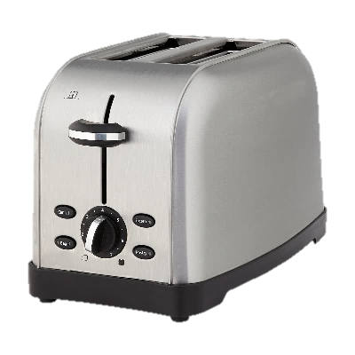
Shameless Plug for V3NLP Framework: http://inlp.bmi.utah.edu/redmine/docs/v3nlp-framework/index.html
Notes:
I am …
I am going to change focus from looking across
the creates from the top, but look at the creates
from shared functionalities and people.
Framework is a shared set of tools and apis that spans
across groups –
Framework is not an application – but a repository of many
Functionalities that are being harnessed to build up applications
For tasks.

Slide 33
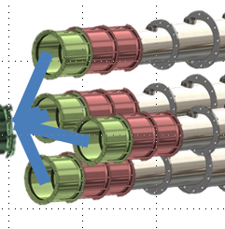
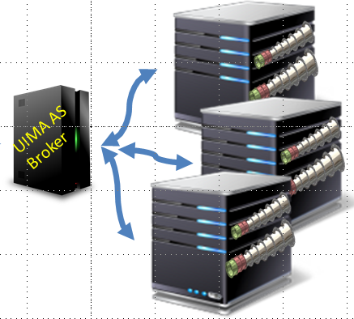
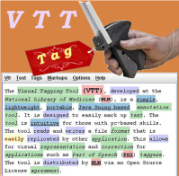
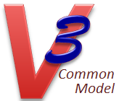
Innovation
Scaled-up Applications
Remote
Service Annotators
Scaled-Out
Applications
Readers
Annotators
Pipeline Applications
Knowtator
Pipelines
Utilities
Writers
Text/CSV

Slide 34
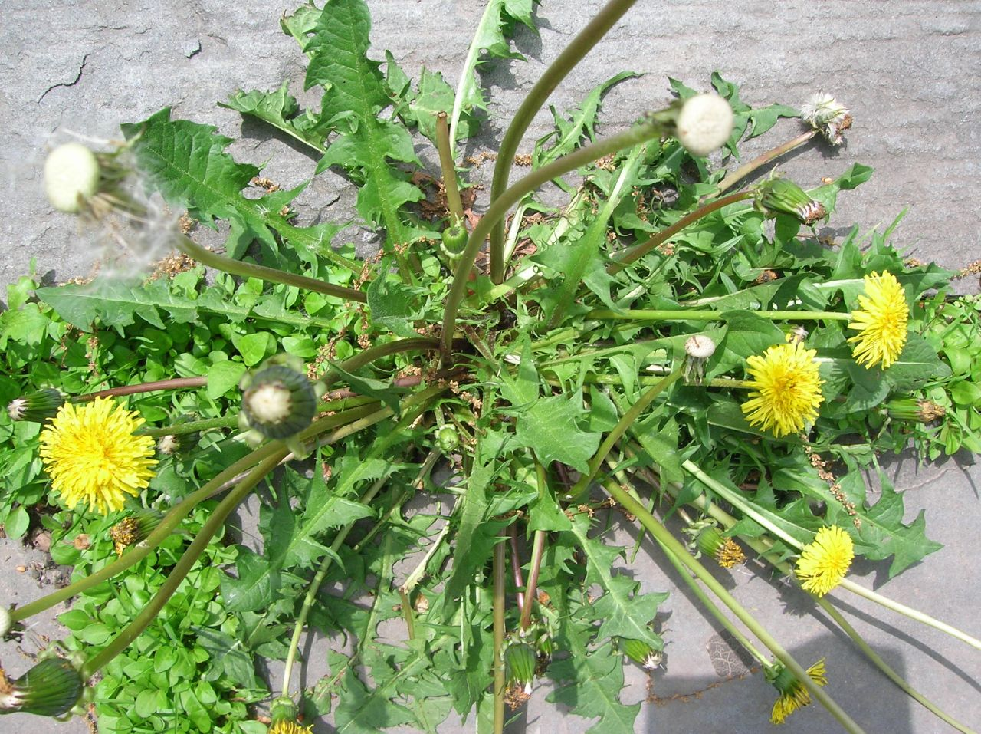

Slide 35
Pipeline Components Slot: Value
Content Heading
:
Content Value
Smoking
:
No
Concepts not looked for here
Concepts in content headings only asserted if content value contains positive evidence
Nursing Notes
Vitals
Slot:
Value

Slide 36
Pipeline Components: Question/Answer Identification
Content Heading
?
Content Value
Do you want to hurt others?
?
yes
(Answer)
(Question)
Negative Evidence sought out
Concepts in content headings only asserted if content value contains positive evidence
Question?
Answer

Slide 37
Pipeline Components: Checkboxes
Content Heading
Content Value
Smoking
Y [ ] N [x]
Concepts in content headings only asserted if content value contains positive evidence
Negative Evidence sought out
Check Boxes

Slide 38
Colonoscopy Quality: Bowel Prep Annotator: Classes, Anchors, Evidence
Rule
Bowel Preparation Class = Bowel prep Anchor + Bowel Prep Evidence
Category Class
Anchor Category
Evidence Category
Bowel Prep Class
Preparation |prep
Visualization | visualized
Bowel Prep Evidence Class
Good |Fair |Poor |Excellent| Adequate
Bowel prep was good
Bowel Preparation
Colon prep
was
good
Bowel Preparation Quality:
Clinical Text
“good”

Slide 39
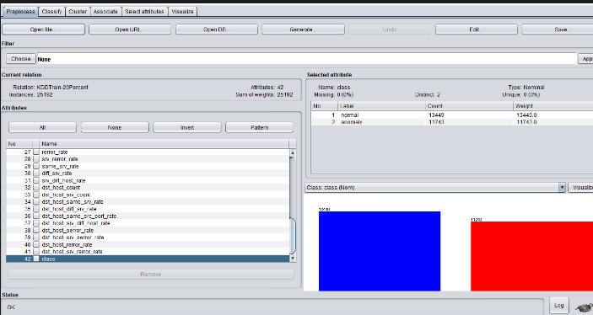
A Picture of Machine Learning
Kinds of Features
Words to left, right of a candidate
Part of speech to left, right of candidate
Section, doc type candidate is in
Topological features (indentation, capitalization, spacing)
Features into Vector per candidate
Each Vector tagged with a known category answer

Slide 40
Other Examples
Suicide Prevention
Classifying Suicide Notes – John Pestian
Real-time Topic Models for Crisis Counseling – Karthnik Dinakar et al.
An automated online crisis dispatcher – Siska Fitrianie, Leon J.M. Rothkrantz
PTSD
Measuring Use of Evidence Based Psychotherapy for Posttraumatic Stress Disorder – Brian Shiner et al.
Ejection Fraction
Jenifer Garvin, et al., S Pakhomov, et al.
Sentiment Analysis, Emotion Detection
Alternative Medicine

